Slide 1


Alpha Phi Omega
Chi Chapter at UCLA
Alpha Mu / Kay Krenek Term, Meeting 6
November 19, 2014
www.apo-x.org

Slide 2
Agenda
1. Officer Updates and Announcements
2. Swear in George Hsin as SAA
3. Excomm Music Videos
4. Last General Announcements
5. Mid-Chapter Evaluations

Slide 3
President
Raymond Mai
president@apo-x.org
Executive Committee
excomm@apo-x.org

Slide 4
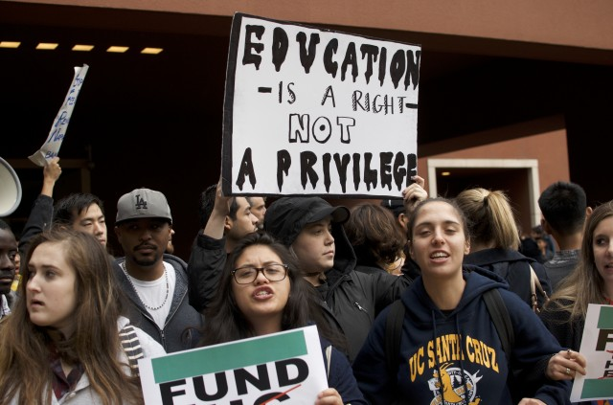
Serious News Relevant to You
UC Regents voted today, 7-2 in favor of the Five-Year Tuition Incease Plan, maxed at 5% a year
Additionally, UC Regents recently voted to raise the salary of FIVE UC chancellors, three being at least 20%

Slide 5
Serious News Relevant to You
On behalf of USAC, we apologize for not advocating harder
The conversation is not done yet
My commission, the Financial Supports Commission, will continue to seek out ways to help you afford UCLA

Slide 6
Leader of the Week

Slide 7
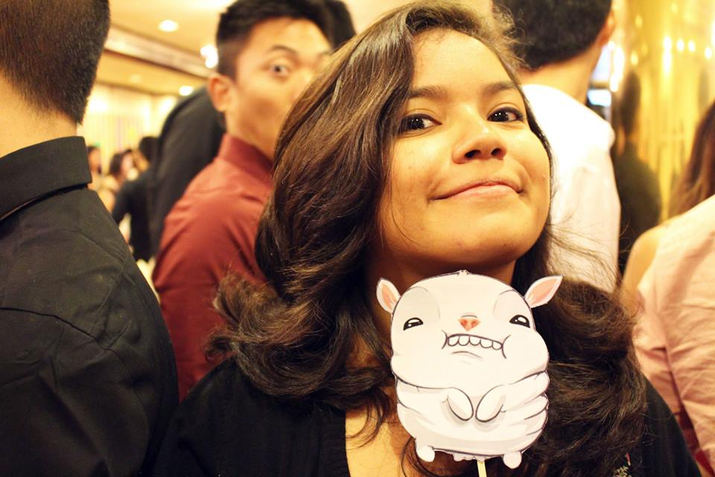
Leader of the Week
Katherine Cardoza

Slide 8

Mental Health Awareness
Recently, the UCLA Undergraduate President, Devin Murphy, stepped down due to the position affecting his physical and mental health.

Slide 9

Mental Health Awareness
DEPRESSION:
Characterized by:
Hopelessness, worthlessness, sadness, guilt, irritability
Could be response to grief or disappointment
Ways to tackle this issue:
Do something you love to do on or off campus
Be active. Take a FitWell class at UCLA Rec
Surround yourself with positive people
Live healthy: Eat healthy and catch up on sleep
Take an anonymous and confidential screening to see if you or a friend should connect with a mental health professional: http://screening.mentalhealthscreening.org/UCLA

Slide 10

Leadership Events
You can come to Excomm Meetings to fulfill [L] credit
December 2nd: Finding Purpose in APO
Jon Widjaja and Sharon Yu have talked to me about running workshops!
Jon’s will be in a few weeks. Date will be finalized soon.

Slide 11
Last Announcements
KEEP PICKING UP YOUR TRASH PLS.
Taylor Swift is BAE.
Offer constructive feedback or suggestions for Excomm members during Chapter Evals
NO MEETING NEXT WEEK BECAUSE OF THANKSGIVING!
We will be opening nominations for Alpha Nu Excomm during CM7, December 3rd.

Slide 12
Administrative VPs
Kevin Quizon & Nicola Yip
admin@apo-x.org

Slide 13
Things you might not have known about the website....

Slide 14
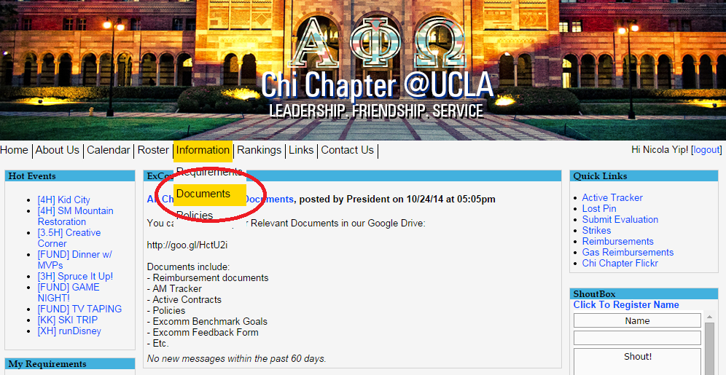

Slide 15
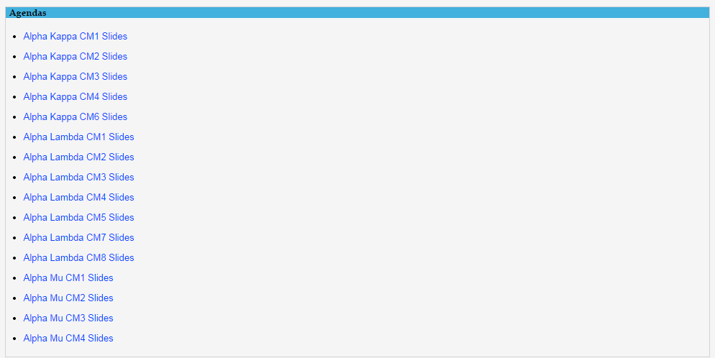

Slide 16
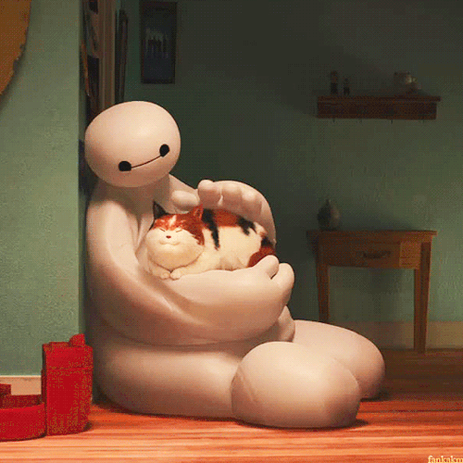
Alumni Mentorship!
LAST CHANCE TO APPLY!

Slide 17
MEMBERSHIP.
Jeremy Gozzip & Andrew Suh
membership@apo-x.org

Slide 18
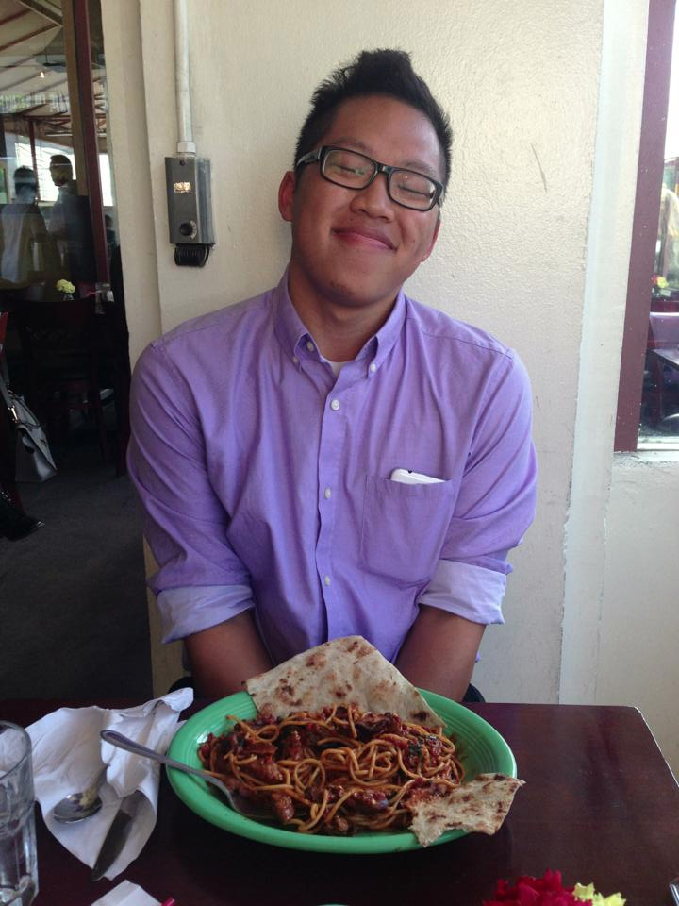
Honorary Bruh
JONATHAN WIDJAJA
pledged Alpha Theta term
Phi Family
a loving Big to 2 LITTLES
Maggie Poon
Sally Chu
current member of our Retention Committee
THANK YOU JON FOR PUTTING TOGETHER ALL OF THE MID-CHAPTER EVALUATION PRESENTATIONS.

Slide 19
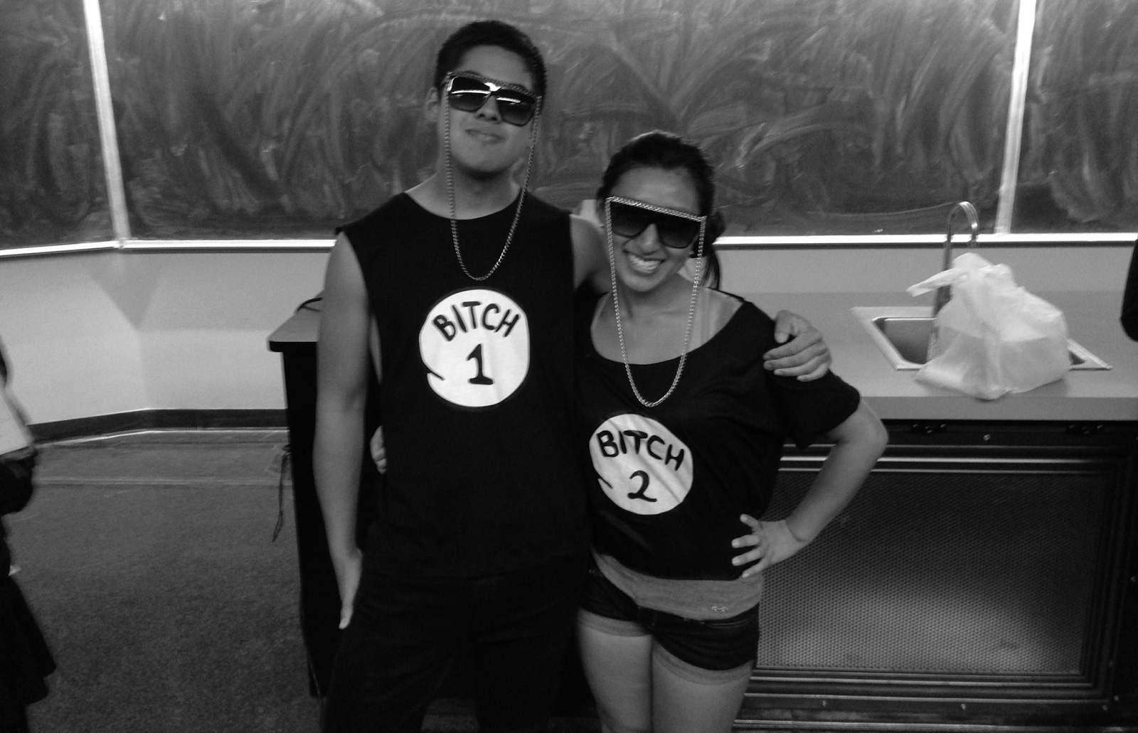
BIG Appreciation DAY!
How much do you
love your BIG?!
SOO MUCH RIGHT?!
Show how much
you appreciate them
by matching outfits to next CM. :)
(December 3rd)

Slide 20

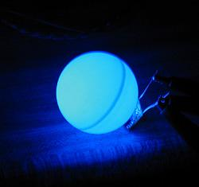
*Pledge Parents backstory*
Ratchet Gurl

Slide 21
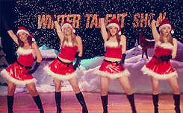
Special Achievement #3
5 people from their respective families must go surprise an
ExComm member at their
dwelling and sing them a
holiday carol.
*must be a surprise*

Slide 22

Shoutout Book!

Slide 23
Service VP
Rui Guo
apoxservice@gmail.com

Slide 24
Kid City
BE A MENTOR!
Every Tuesday at 3:30 pm in DTLA
USC APO WILL BE THERE THIS THURSDAY TOO!
Flake in if you are interested! 3 spots left

Slide 25
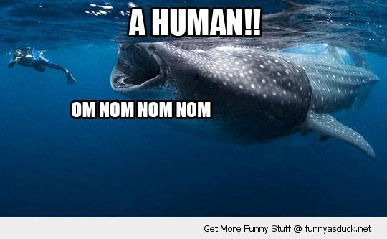
MPA Watch
IT’S BACK …..in December
ONE SPOT OPEN THIS FRIDAY IF ANYONE IS INTERESTED

Slide 26

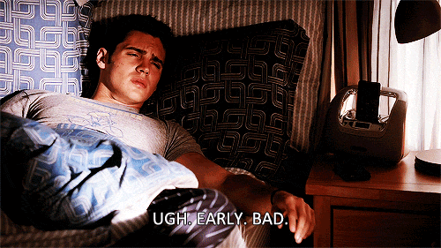
runDisney
Our start time is …..2:00 am Friday morning
If you are still interested and can make it
please sign up!

Slide 27
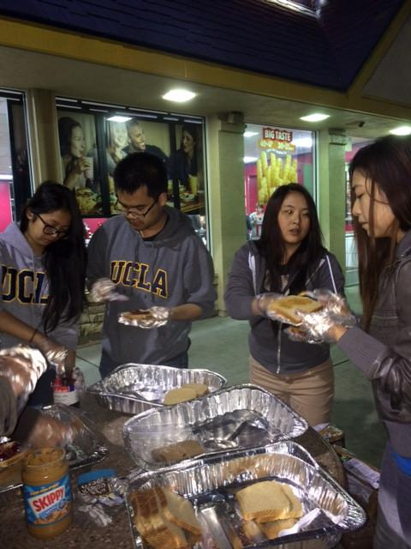
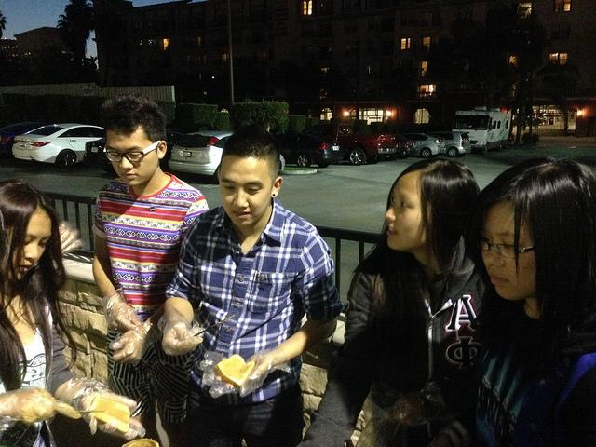
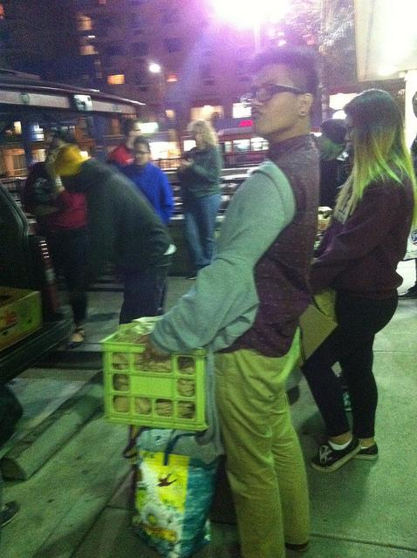
Service Highlight: MNM
Monday Night Mission!! feat. Althea Alquitran

Slide 28

Pledge Parents
Brian Lee & Emily Neai-Proeung
apoxpparents@gmail.com

Slide 29
Quiz/Missions
Interviews: 10 actives (due PM7, 12/3)
Quiz: Founding Fathers & Types of Service (PM7, 12/3)
Mission:
Service with your Big! (due by PM7, 12/3)
Tentative Mission (during the day; 12/3)

Slide 30
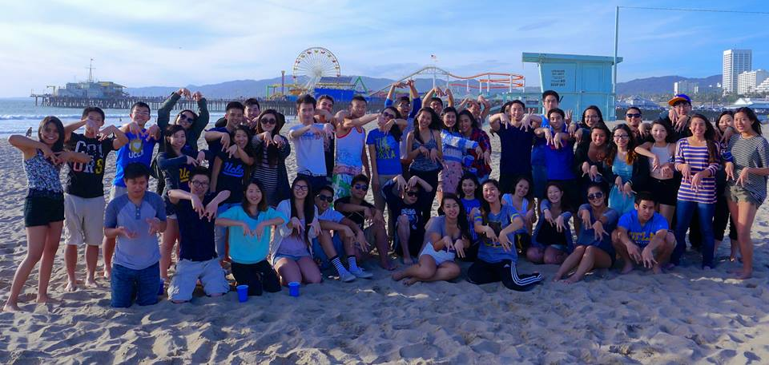
[KK] ic pledge event

Slide 31
[KK] ic pledge event
https://vimeo.com/112136821

Slide 32
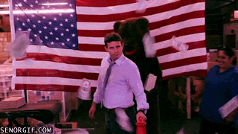
[KK] Fundraising pledge event
Keep an eye out for some FUNdraisers :3!
Boba Sale
Bake Sale
Pie the Pledges
Come out to support Alpha Mu Class!

Slide 33
Finance VPs
San Li & Jonathan Liu
finance@apo-x.org

Slide 34
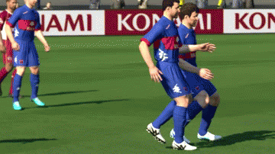
$$$$$$$$$$$$$$$$$$$$$
Pledges please pay me $20 TODAY merci beaucoup!
Actives: Last payment next week! (not necessarily $20)

Slide 35
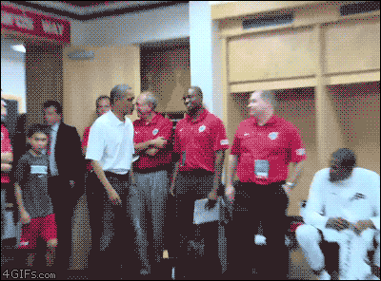
Fruit Cups & Cake Pops!
Thanks to those who helped prepare and sell fruit cups and cake pops!
Tracker will be updated with fundraising credit soon!

Slide 36
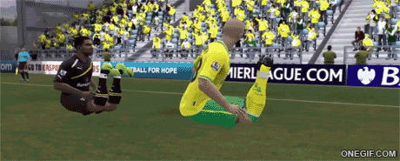
Fundraising Clarification
Your credit is not necessarily how much you raise during your shift!
Fundraising credit is revenue - costs! i.e. profit!

Slide 37
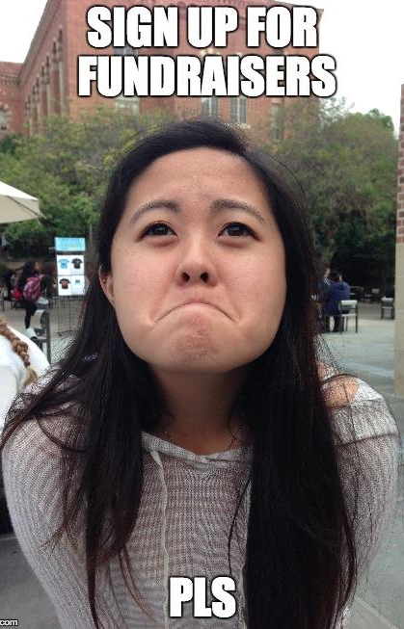
Upcoming Fundraisers
Tue. Nov 25 - TV Taping - The Millers
Fri. Dec 5 - TV Taping - The McCarthys
Sat. Dec 6 - Game Night
Mon. Dec 8 - Krispy Kreme Delivery
Sat. Dec 13 - TV Taping - America’s Funniest Videos
5-9 people = $14 per person
10-14 people = $16 per person
**Spam Musubi Delivery Week 2 of Winter Quarter**

Slide 38
Fellowship VPs
Ann Dai & Danny Ly
fellowship@apo-x.org

Slide 39
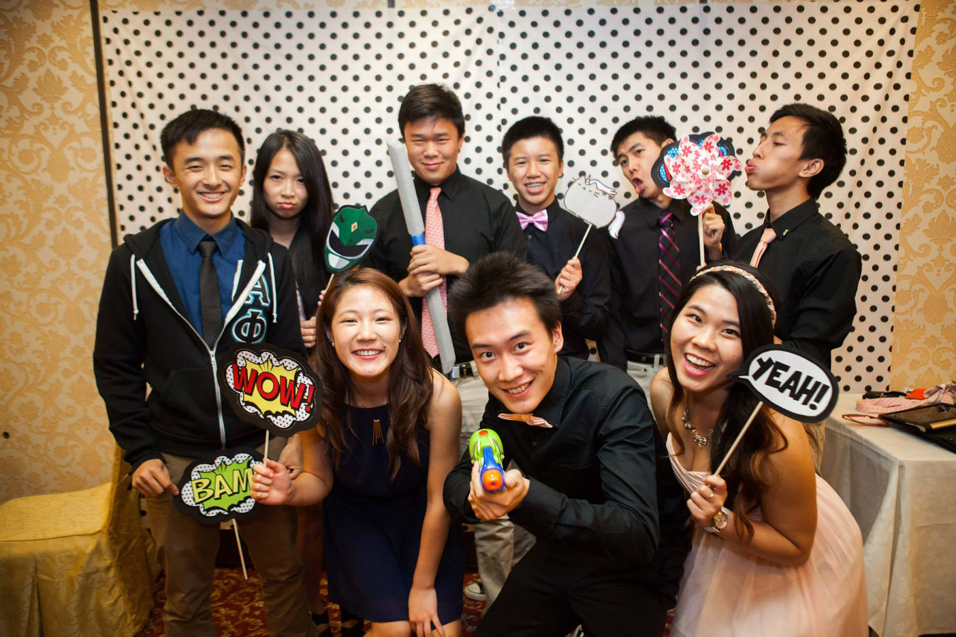
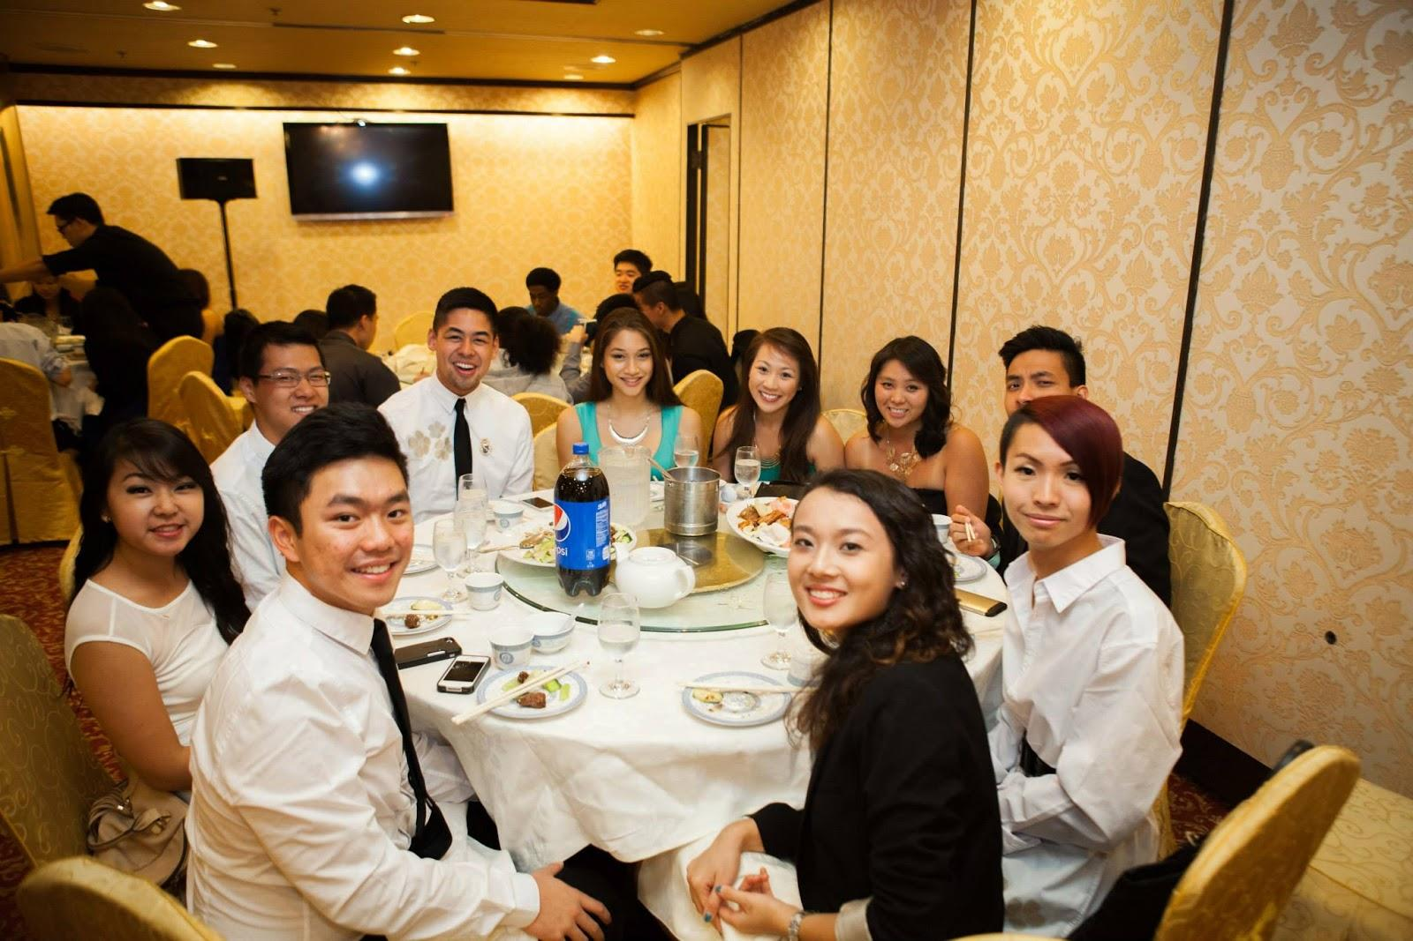
Thanks for coming to lgn!
We hope you guys had a good time! YOU WERE ALL BEAUTIFUL

Slide 40
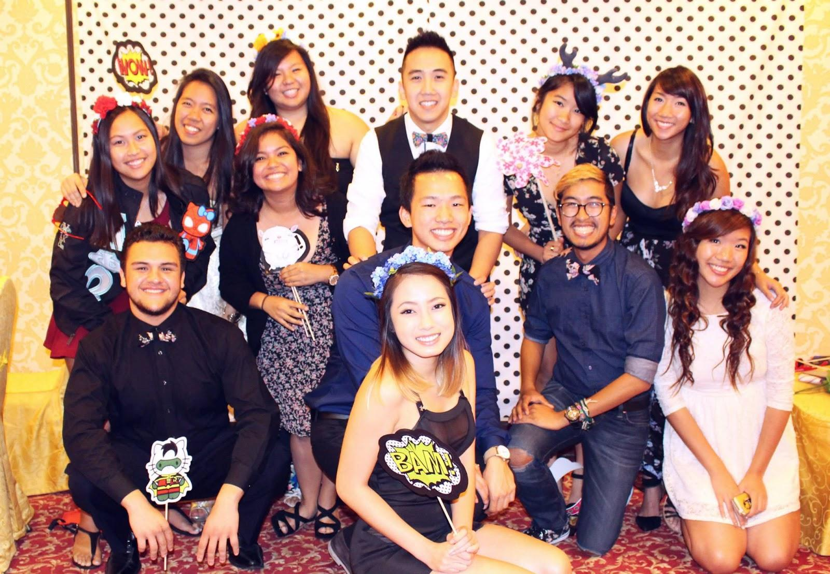
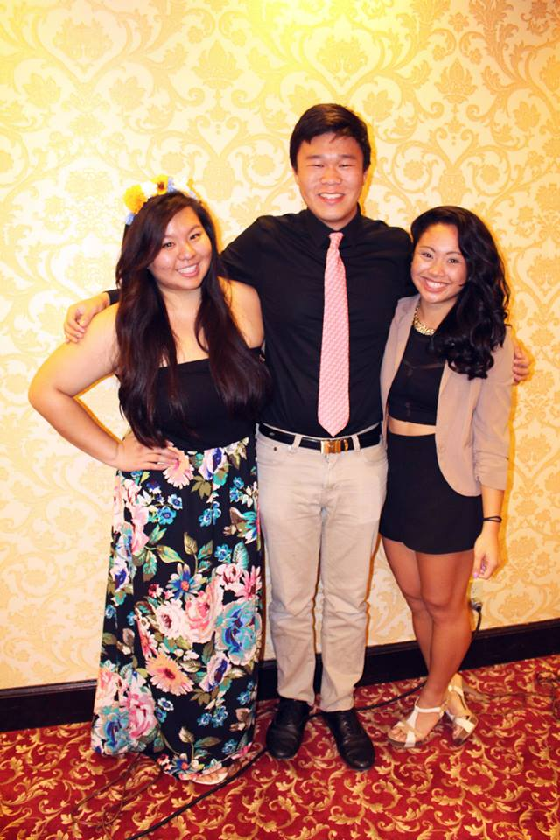
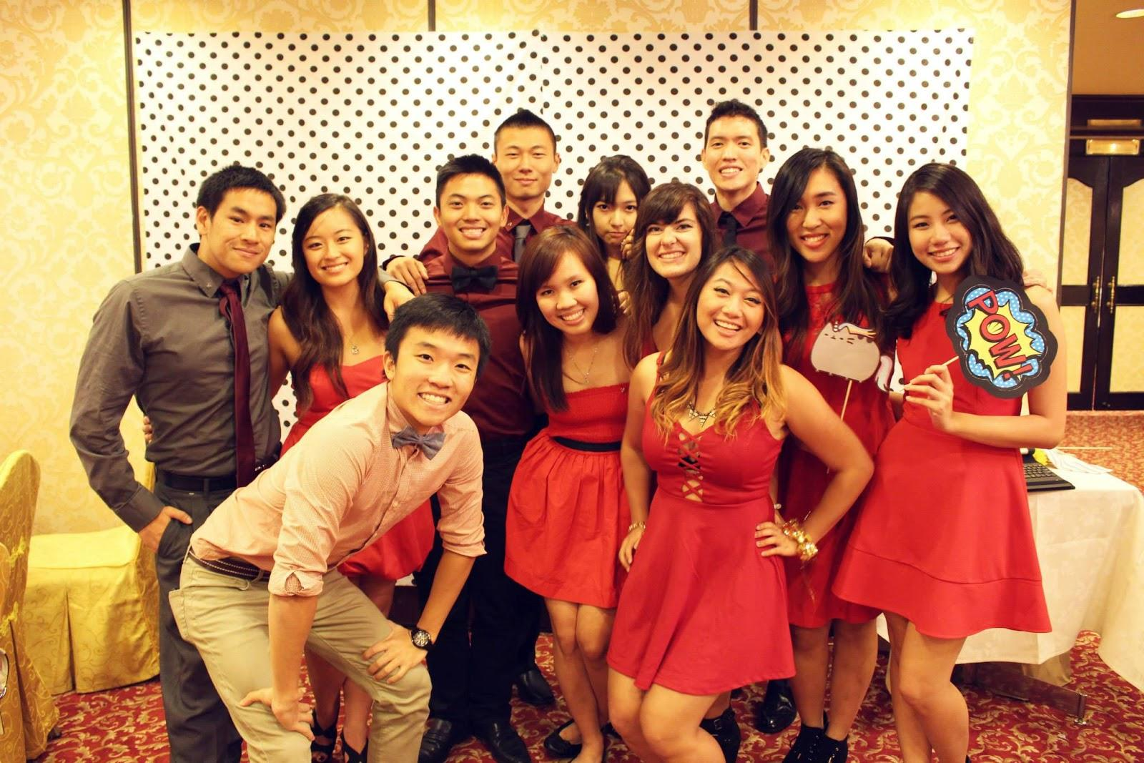
Thanks for coming to lgn!
We hope you guys had a good time! YOU WERE ALL BEAUTIFUL

Slide 41
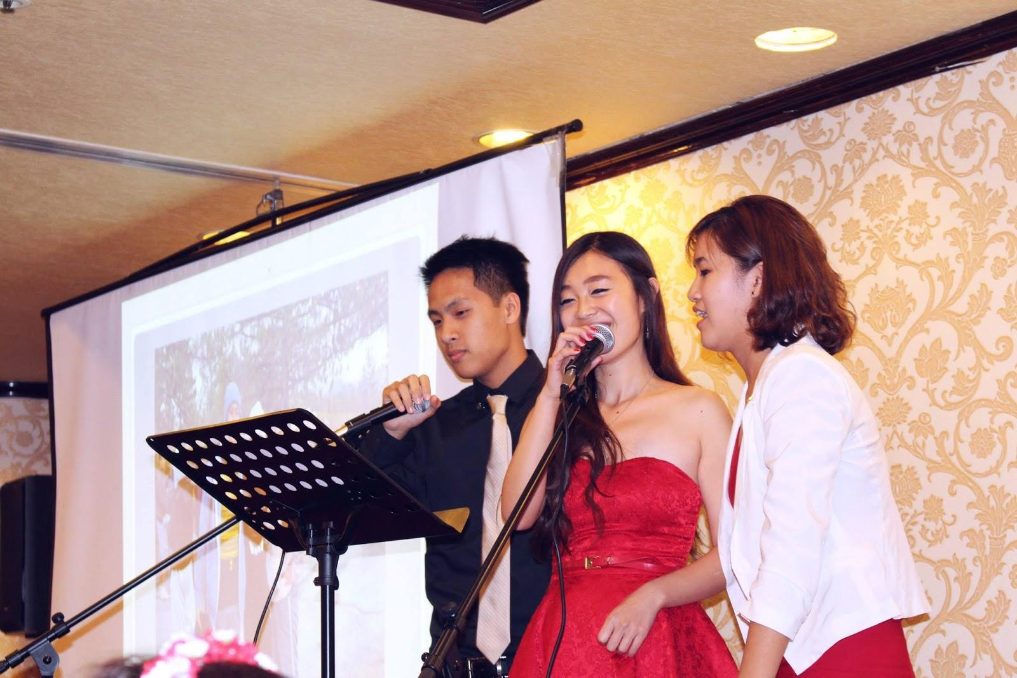
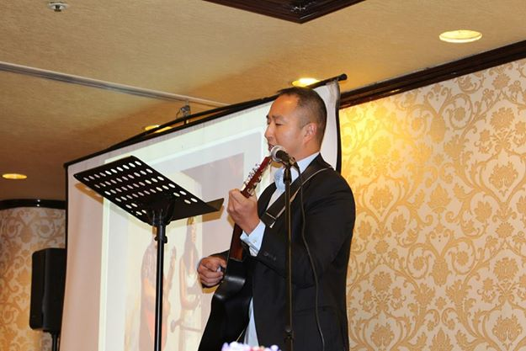
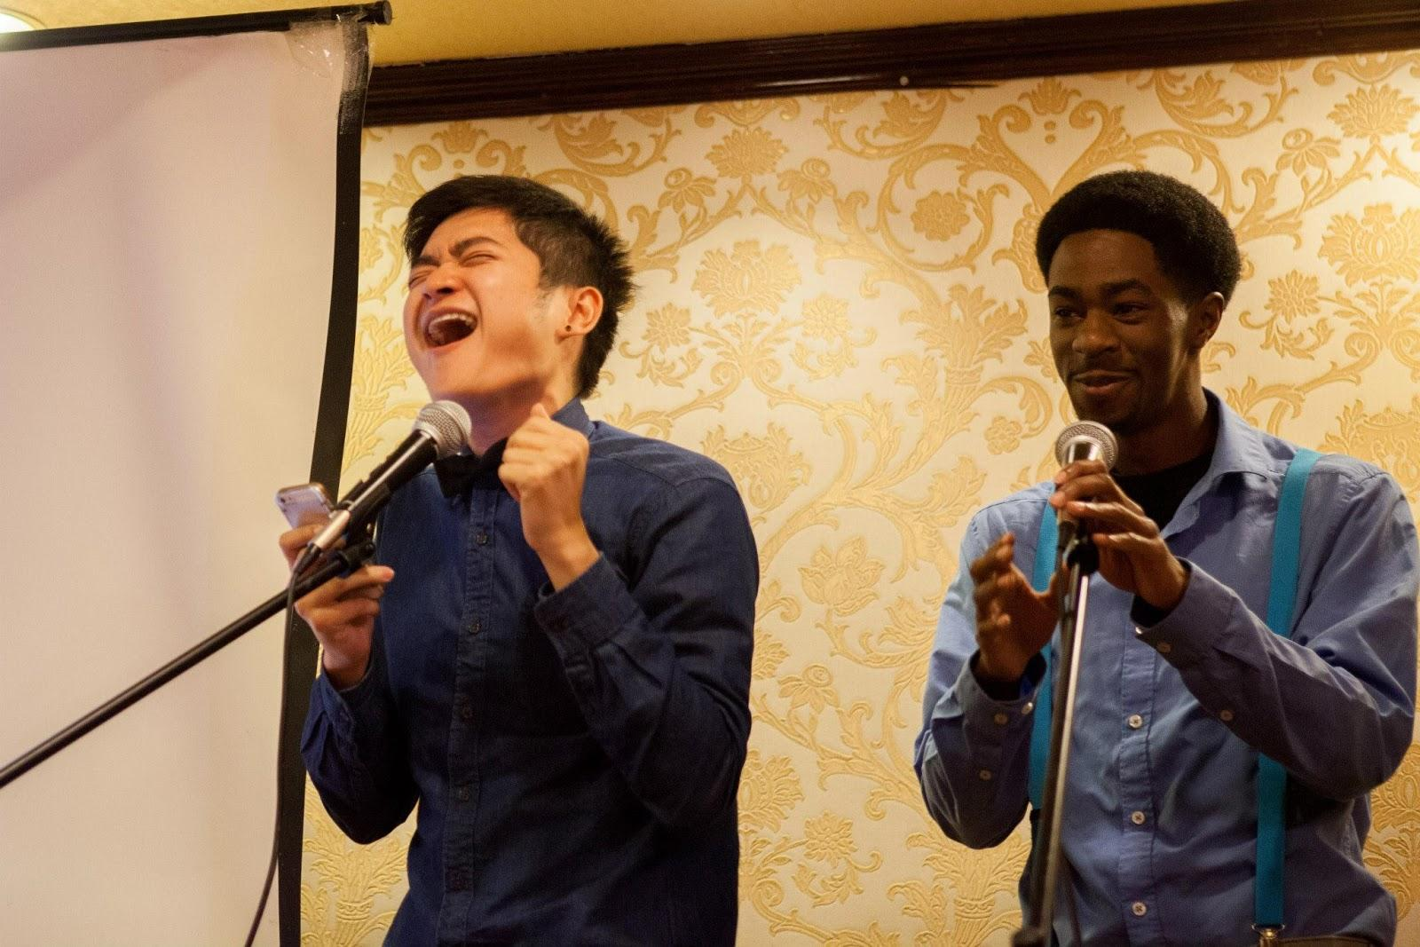
Thanks for coming to lgn!
Thank you to all the performers you were amazing!!

Slide 42
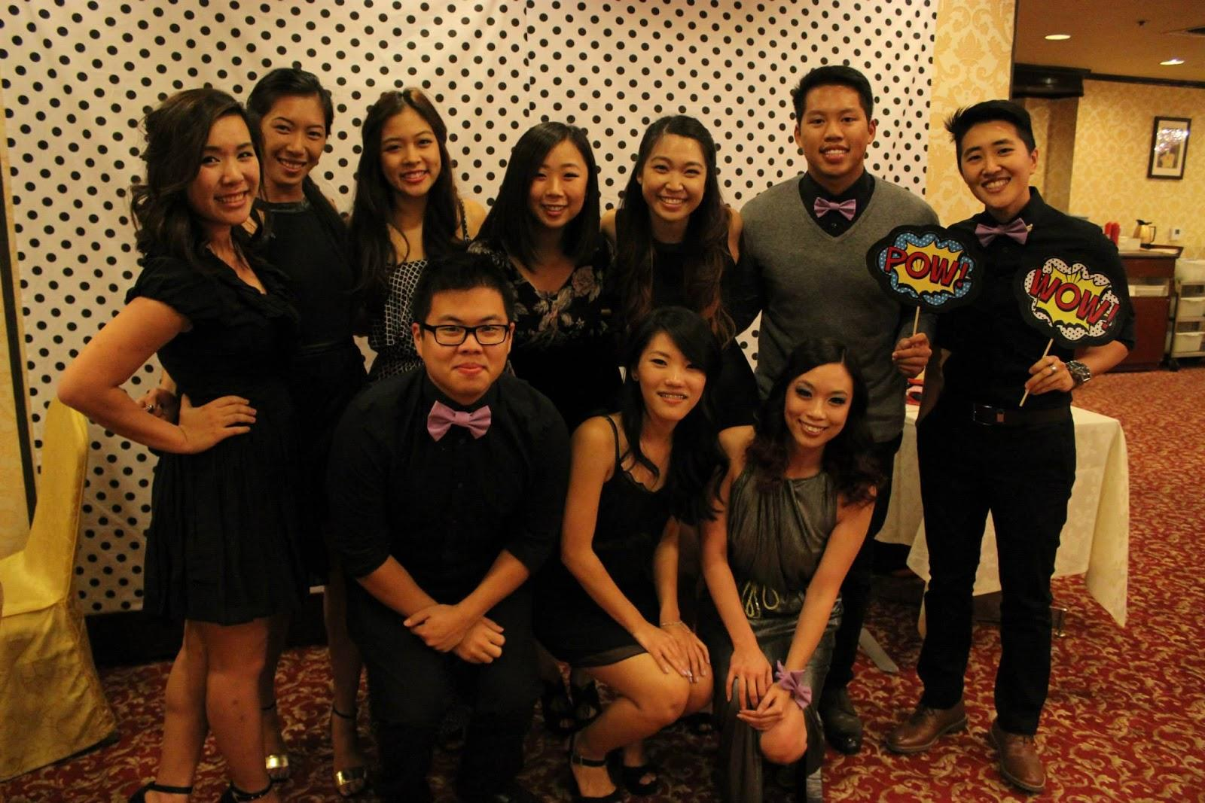
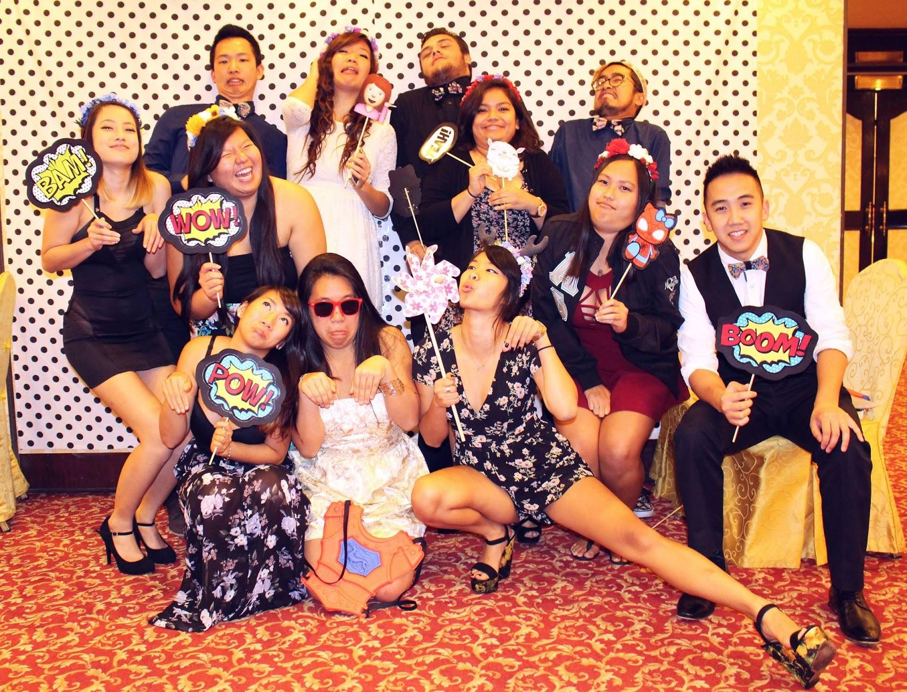
GIfTs for Winning Line + Drivers
Guess Brothers>>>> Good Looking Line Guess Songs>>>> SMF

Slide 43
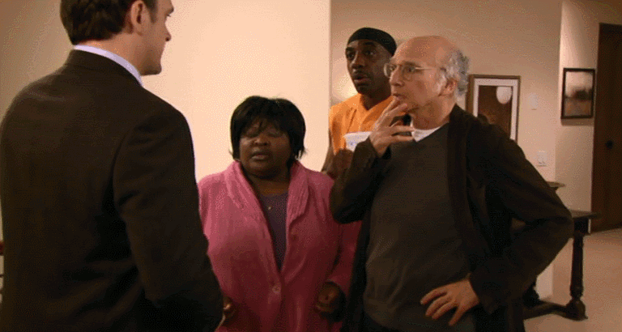
Fun foursies!
Fun Foursies is due tonight!
Please email in a picture of your group hanging out by 12 AM tonight
Email to apoxfellowship@gmail.com
New groups will be sent out soon!

Slide 44
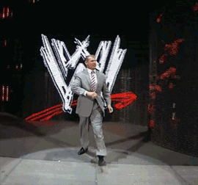

IM Sports
IM Volleyball
We made playoffs YAY!
No game this week, playoffs start Dec 1
IM Indoor Soccer game 11/20
7:45 PM in SAC
Please come play or support!

Slide 45
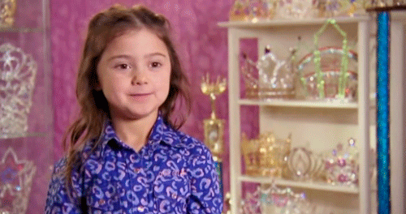
New fellowships up soon!
Let us know if you would like us to put up an event for you (at least 5 days in advance pls)
Keep an eye out for new events on the calendar!

Slide 46

good luck!
Good luck on Midterms we love you!

Slide 47

Historian
Juana Li
historian@apo-x.org

Slide 48
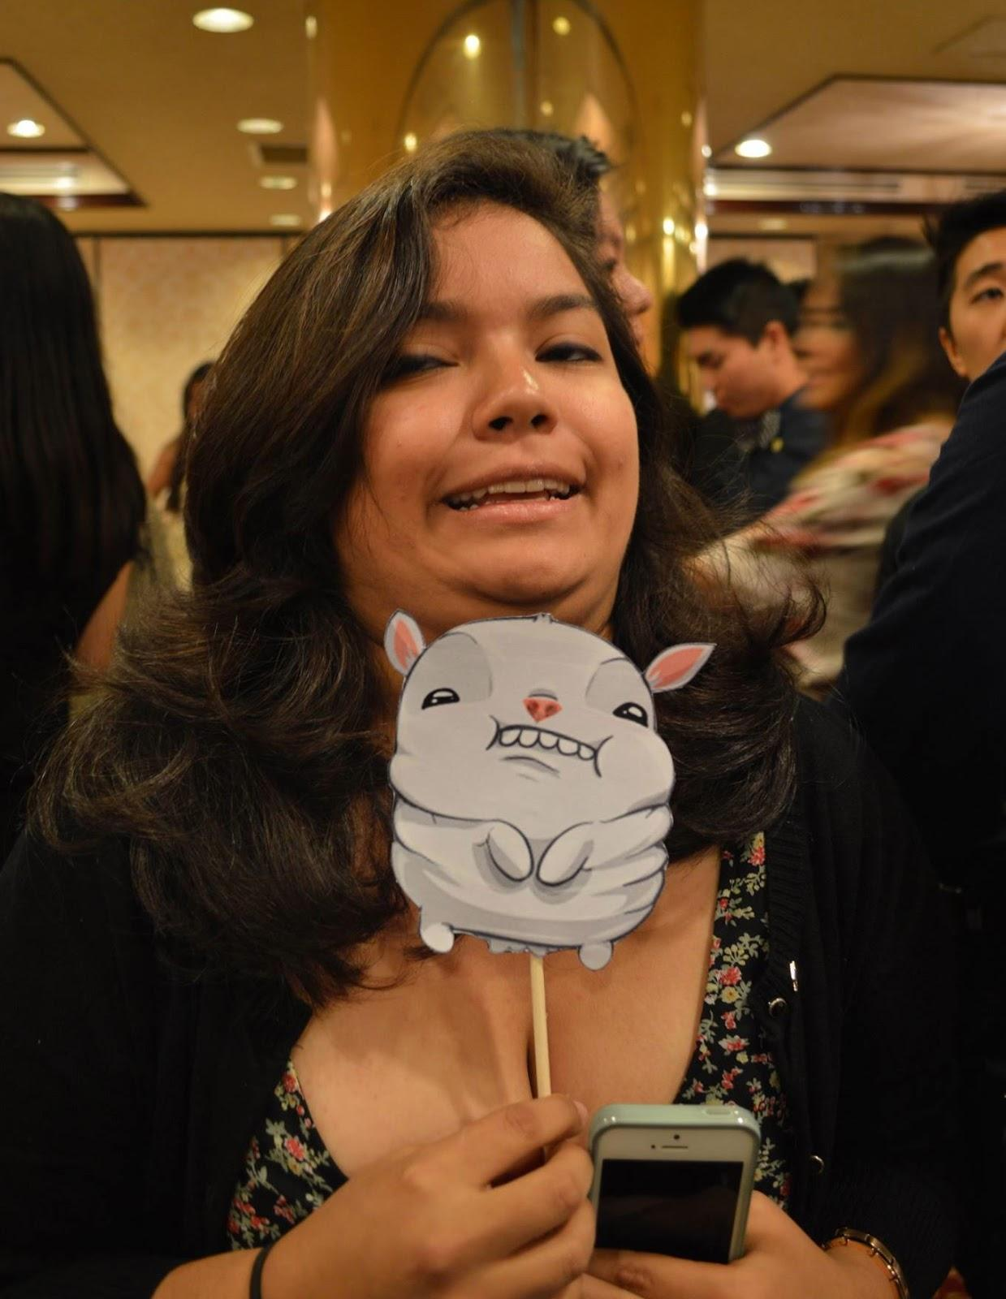
Brothers of Chi Chapter
Winner:
Katherine Cardoza: “NOOOOOOOOOOOOO”

Slide 49
Brother of the Week
This weeks brother is someone who...
-Is a part of the Alpha Theta Class
-Has served on Excomm last term
-Has a twin who also pledged Alpha Theta
-Is a part of the Phi family

Slide 50
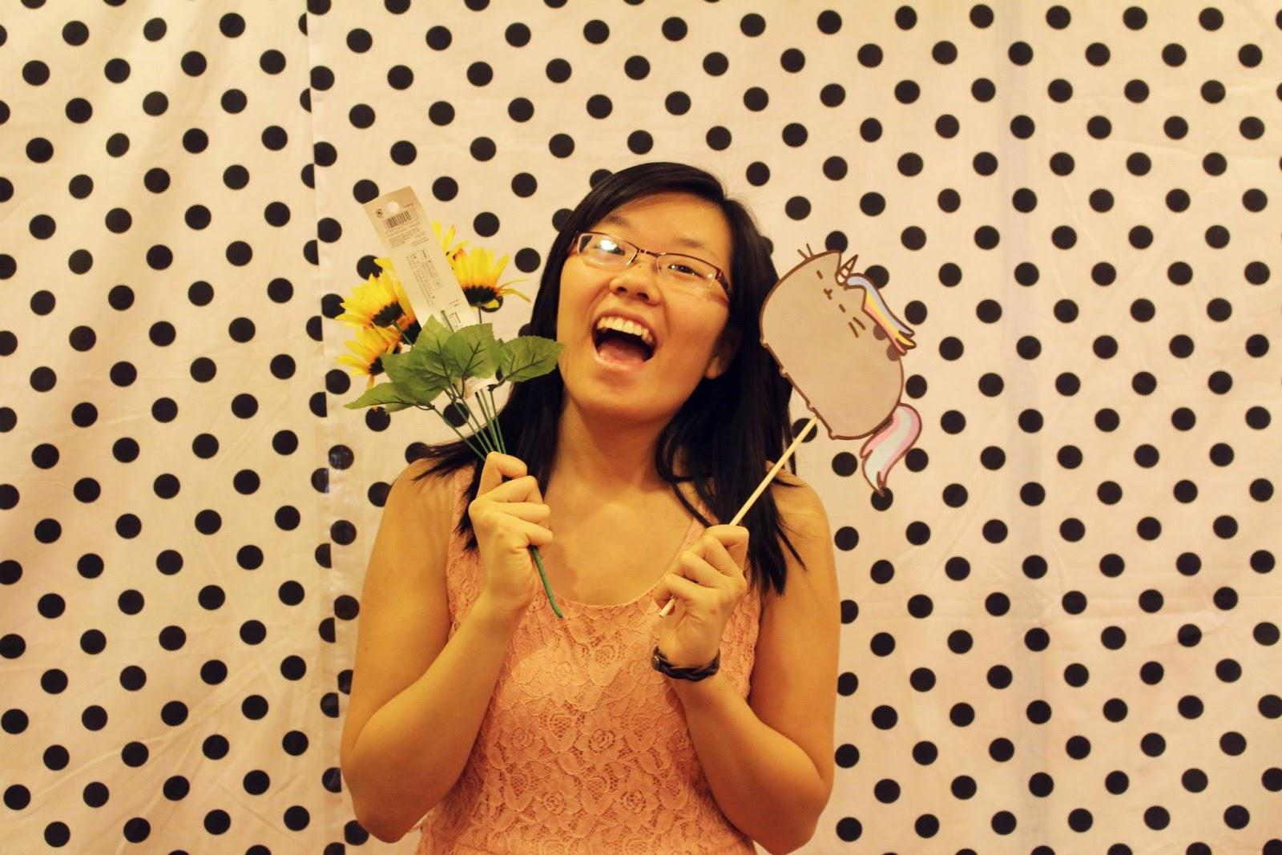
Melissa Ma

Slide 51
Webisode #3
Enjoy! =D

Slide 52
Sergeant-at-Arms
George Hsin
apoxsergeant@gmail.com

Slide 53
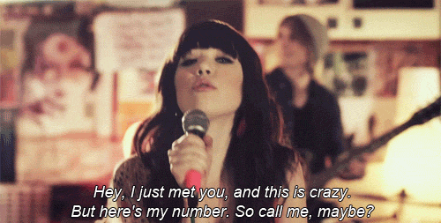
Google Voice
SAA Number
-(424) 216-8319
-Send all information regarding SAA to this number

Slide 54
Chairing
Email 3 days prior to event
Ex: Friday event, send out email on Tuesday
Text/Call 1 day before
Text before 9PM, Make sure to include all relevant information and INCLUDE YOUR NAME
If no response by 9PM, must call before 10:30PM
*Receiving Chairing Credit
Must follow above guidelines and send in Evaluation
Will only receive credit if rules 1&2 are completed
IMPORTANT: Must send in eval for people to get credit for the event, however no chairing credit will be given

Slide 55
Strike Cards
NO MORE/GONE
People continually talking during meeting will be given a warning email from SAA
2 warnings will be a strike

Slide 56
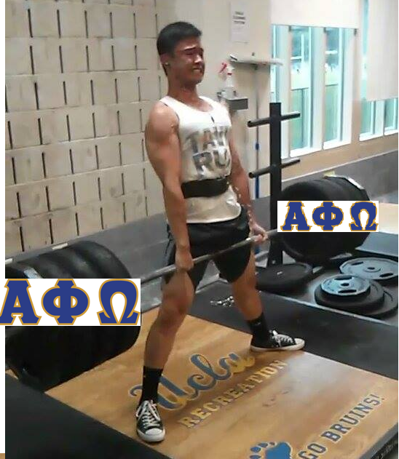
Questions?
I’m here to “LIFT THE WEIGHT” off your shoulders
*All Policies will go into effect after this meeting.
If you have any questions or concerns feel free to text/call the SAA number, or email me

Slide 57
Interchapter Chair
Chanel Ng
interchapter@apo-x.org

Slide 58


Phi Delta BBall Tournament
8-10 players with a team fee of $24 ($3 per player)
Deadline to submit teams by November 20th, 11:59 PM
Cheerleaders are welcome :)

Slide 59


Alpha Delta’s APO Formals
November 21, 2014 at SDSU for $FREE.99!!!
Deadline to RSVP is tomorrow!

Slide 60

ICDC Workshops
Thanks for coming out to ICDC Workshop Uno!
ICDC Workshop Part II is on the calendar!
November 24th @ 8PM

Slide 61


Interested in...
IC Penpal?
Nationals Roll Call Video?

Slide 62
Reminders
Please direct all questions or concerns to apoxinterchapter@gmail.com
Chairs please see me for IC friendship bracelets :)
Pls gimme da $$$ for shirt orders from Rho Rho

Slide 63
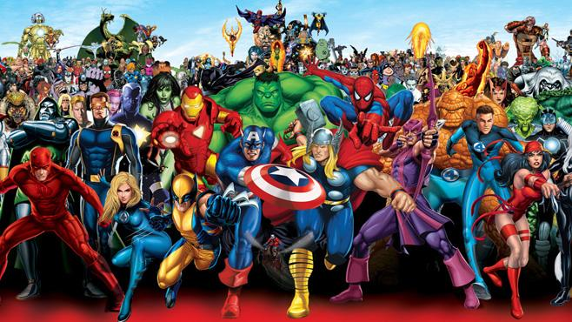
CAC
Paul Choung
cac@apo-x.org

Slide 64

SHADY
APO
presented by ACS

Slide 65
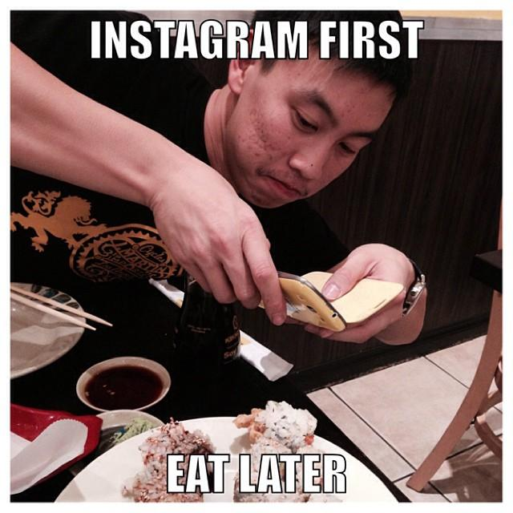
Gordon Huang
Spring 2008
- Bonnie Chen pledge class

Slide 67
Mid-Chapter Evaluations – Actives Alpha Mu Fall 2014

Slide 68
Active Requirements (63 Responses)
Dues
30.5% want less
69.5% just right
CM Attendance
18.6% want less
79.7% just right
1.7% want more

Slide 69
Active Requirements (63 Responses)
Rush/Flyering
4.8% want less
95.2% just right
0% want more
Leadership
6.3% want less
92.1% just right
1.6% want more

Slide 70
Active Requirements (63 Responses)
Chairing (Leadership)
7.9% want less
90.5% just right
1.6% want more
Committee (Leadership)
7.9% want less
85.7% just right
6.3% want more

Slide 71
Active Requirements (63 Responses)
Workshop (Leadership)
14.3% want less
76.2% just right
9.5% want more
Service Hours
4.8% want less
84.1% just right
11.1% want more

Slide 72
Active Requirements (63 Responses)
Fellowship
3.2% want less
90.5% just right
6.3% want more
Fundraising
17.5% want less
80.9% just right
1.6% want more

Slide 73
Active Requirements (63 Responses)
Interchapter Events
7.9% want less
85.8% just right
6.3% want more
Chapter Events
12.7% want less
79.4% just right
7.9% want more

Slide 74
Active Requirements (63 Responses)
Family Events
1.6% want less
84.1% just right
14.3% want more

Slide 75
Meetings
What do you expect from meetings?
60.3% Games and Bonding + Business
39.7% Strictly business
How long should chapter meeting take ideally?
11.1% want 30-45 minutes
57.1% want 1 hour
22.2% want 1.5 hours
9.5% want as long as it needs to be

Slide 76
Issues in the Chapter?
Too many cliques, gossip, drama, rumoring
Too time consuming
Lack of retention
Lack of respect within chapter
Long, inefficient meetings
ExComm is disconnected
Lack of active involvement
Lack of acknowledgment of brothers who are outside of your clique

Slide 77
Issues in the Chapter?
Some people are not as good of role models as they should be
Lack of interest in Chapter Business during meetings
Lack of passion and spirit
Feels more like a club and not like a fraternity/brotherhood

Slide 78
What does APO mean to you?
Why are you involved and what do you expect to gain out of it?
Are you getting what you want out of it? What can be improved on to help you reach your goals?

Slide 79
How to Improve?
Don’t be so afraid to talk to a Brother that is not in your clique or invite them to hang out
Reduce requirements for older actives
Hang out outside clique
Need willingness and effort to change
Have individual integrity and honesty
Shorter meetings
Have a meeting to talk about gossip issues
Stricter pledging

Slide 80
More/Less Events on Calendar?
Family Events
77.8% want more
7.9% want less
14.3% as is
Family Competitions
57.1% want more
25.4% want less
17.5% as is

Slide 81
More/Less on Calendar?
Service
77.8% want more
3.2% want less
19% as is
Leadership Workshops
69.8% want more
11.1% want less
19.1% as is

Slide 82
More/Less on Calendar?
Fundraisers
60.3% want more
14.3% want less
25.4% as is
Fellowships
65.1% want more
3.2% want less
31.7% as is

Slide 83
More/Less on Calendar?
Interchapter Events
58.7% want more
11.1% want less
30.2% as is
Chapter Events
60.3% want more
11.1% want less
28.6% as is

Slide 84
Any specific events to add?
Dim sum
Boba
Sports
Theme parks
More service/fellowship/IC near campus
Skydiving
Potluck

Slide 85
Excomm (Out of 5)
Efficiency: 3.81
Transparency: 3.79

Slide 86
President
4.46
Swag
Good, detailed communication
Good job being transparent and nagging to pick up trash
Pushes “America” too much, not everyone can relate
Less business and more fun/laughter

Slide 87
Admin VPs
4.29
Nice website changes
Update pledge photos
More alumni stuff
Please follow through with mentorship
Good job with mentorship idea
Speak louder

Slide 88
Membership VPs
4.12
Beginning of term had too many games during meeting, now there are none
More chapter events
Do more things that actives want to do

Slide 89
Service VPs
4.27
Like the incentives
More service at night
More service that aren’t all on weekends
Please do Divine Design
More enthusiasm

Slide 90
Pledge Parents
4.49
Do pairings based on who people want
Great, silly pair

Slide 91
Finance VPs
4.39
Both are not equally prominent
More payment options, get venmo
Spam musubi fundraiser please

Slide 92
Fellowship VPs
4.59
Awesome attitudes
More fellowships, but overall good events
Event recommendations: scary movie night, mahjong

Slide 93
Historian
4.61
Movies are awesome
Very amazing effort into your work

Slide 94
SAA
N/A
Update chairing instructions on calendar
Need clearer policies
Who is the SAA?

Slide 95
IC Chair
4.57
Great job
More IC events on our campus

Slide 96
CAC
4.75
Skits are awesome!

Slide 97
Last Comments - Actives
Very nice improvements
Movie was good but please delegate the tasks more so that one person does not end up doing all the work. Movies take a lot of effort and time

Slide 98
Summary of Pledge Evaluations
Potential Issues
Time-consuming
Observed lack of brotherhood amongst Actives
Want to see Actives be more engaged
Cliques
Concerned about requirements
Amount of events for each category is sufficient

